Slide 1

NIBM Event Management System
Group Project Presentation

Slide 2

Introduction to the NIBM Event Management System
Project Purpose and Objectives
We built a web system to manage campus events effectively.
Identifying the Problem
Students often miss campus events because information isn’t easily accessible.
Our Innovative Solution
Our Event Management System allows admins to add events and students to view them easily.

Slide 3

How We Built This Website & What We Used
Technology Stack Overview
We utilized a powerful tech stack including Node.js, Express.js, and MongoDB.
Development Tools Employed
Our team worked with VS Code, Postman, and MongoDB Compass for efficient development.
YouTube Tutorial Foundation
The project was based on a tutorial that we customized to fit NIBM's needs.

Slide 4
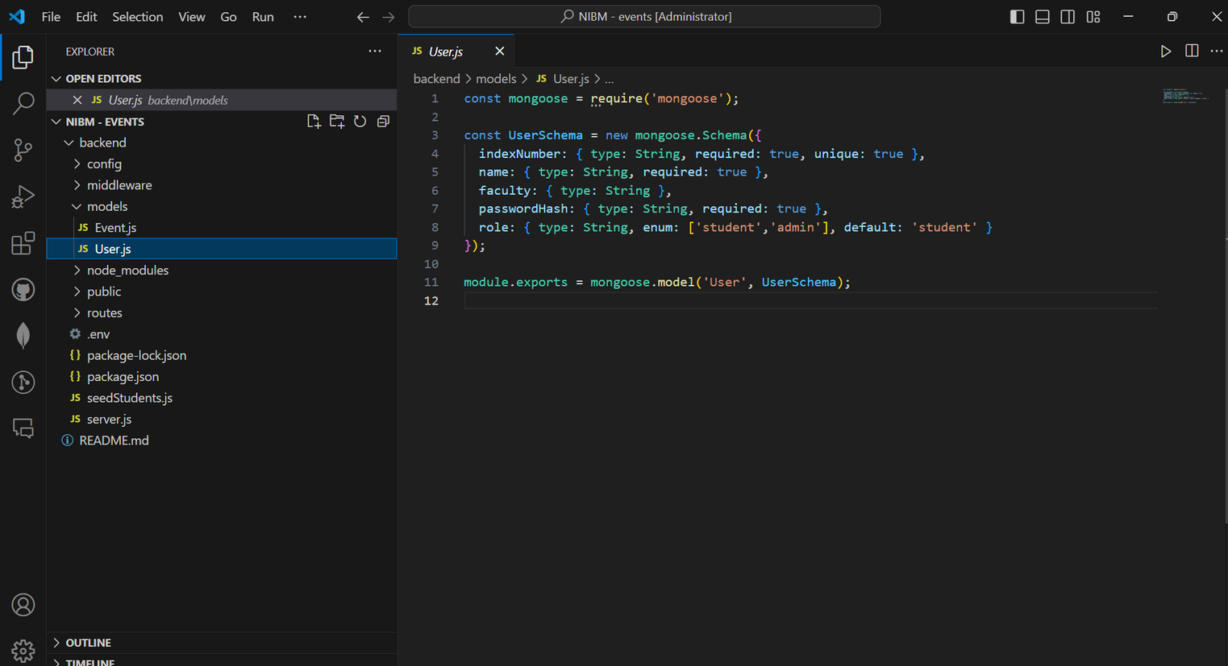
User Model Definition and Roles
User Data Storage
The User model securely stores essential information like Index Number, username, Faculty, Password and Role.
User Roles
There are two roles: Admin for managing events, and Student for viewing them.
Admin Capabilities
Admins can create and delete events, ensuring effective management of campus activities.

Slide 5
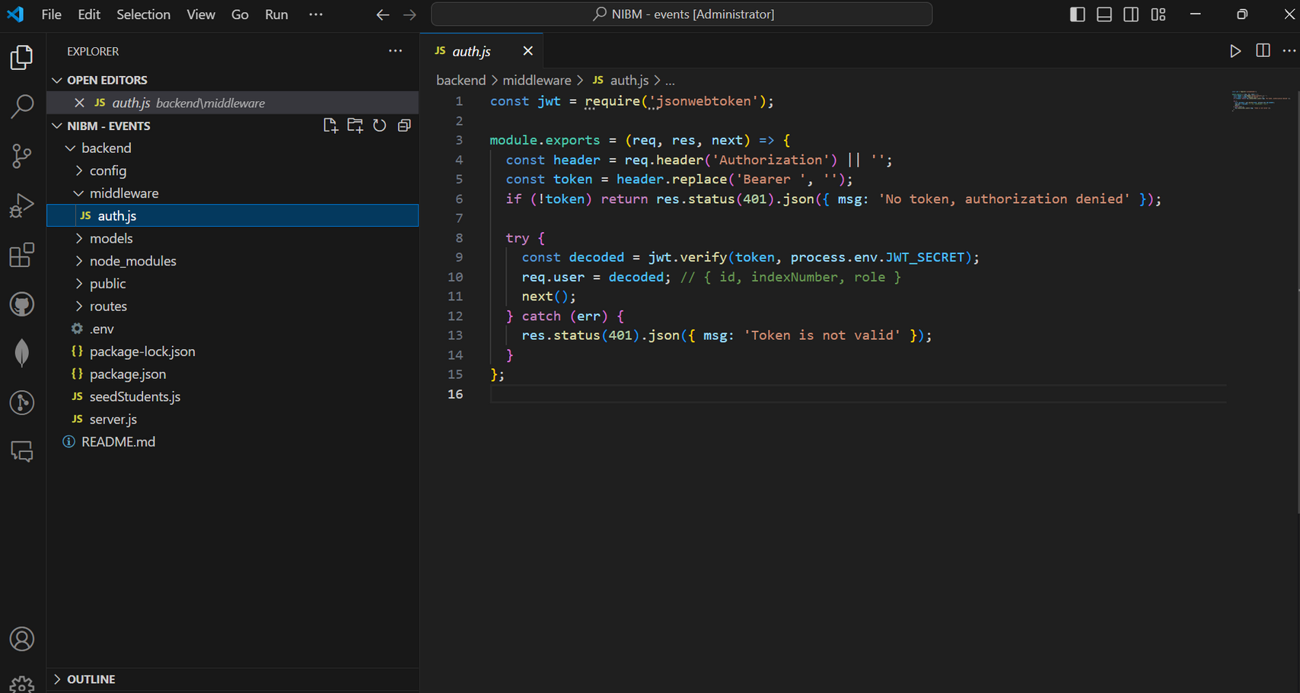
Overview of JWT Authentication and Security
Secure User Access
JWT ensures only authenticated users can access protected routes.
Token Verification
Middleware verifies JWT tokens for secure data handling.
Role-Based Permissions
Different user roles define access levels for event management.

Slide 6
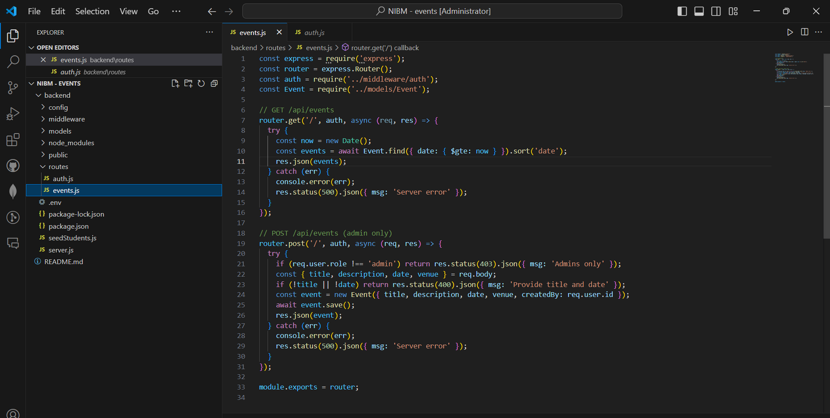
How Events Are Managed: User Interaction and Workflow
Admin Event Creation Process
Admins easily create events through a straightforward form, ensuring timely updates for students.
MongoDB Storage and Management
Events are dynamically stored in MongoDB, allowing real-time access and modifications for users.
Student Event Viewing Experience
Students can filter and view upcoming events, enhancing their engagement and participation on campus.

Slide 7
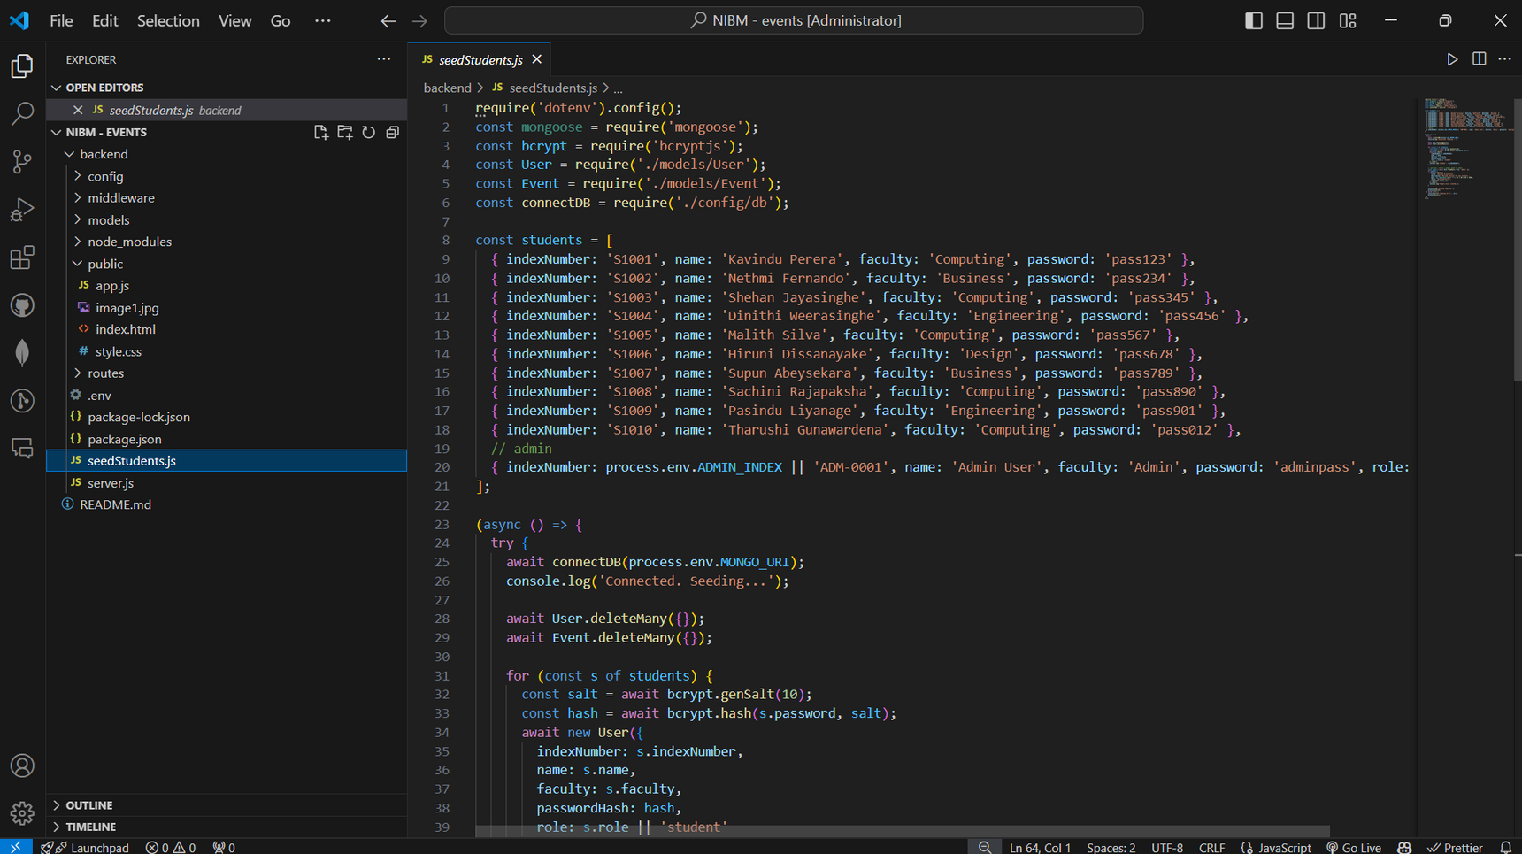
Database Structure and Data Management
Two Main Collections
The database consists of Users and Events, allowing for organized data management.
Dynamic Data Updates
Changes in event status automatically update across the application in real-time.
Efficient Data Retrieval
MongoDB’s structure enables quick access to event details for both admins and students.

Slide 8
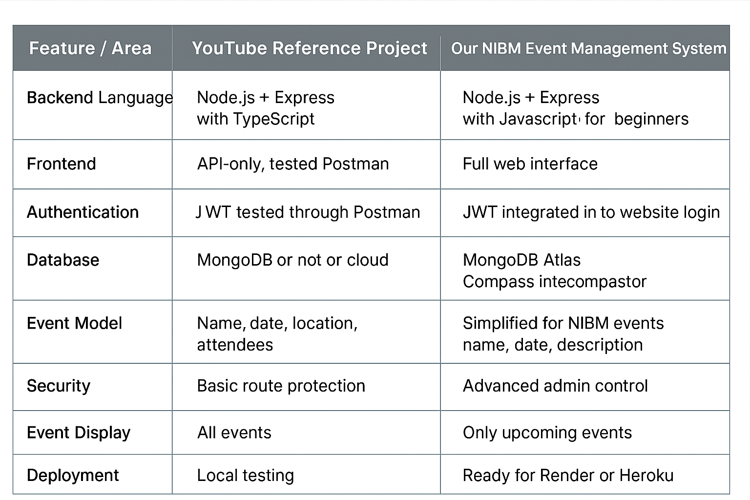
Reference vs NIBM Event Management System Comparison

Slide 9

Key Learning Outcomes from Our Project
Effective Teamwork and Collaboration
We enhanced our teamwork skills by coordinating tasks and responsibilities effectively.
Hands-on Database Management
Gained experience in designing and managing a dynamic database using MongoDB.
Developing Secure APIs
Learned to implement authentication and security measures for web applications using JWT.

Slide 10
Conclusion
Designing databases with MongoDB
Building REST APIs using Express
Integrating frontend and backend
Implementing authentication and authorization

